Slide 1
Movers and Packers

Slide 2
This project present in git repository in below URL
https://github.com/Kaleakash/moversandpackers.git
Plz login to virtual lab and clone this project in virtual lab using command as
git clone https://github.com/Kaleakash/moversandpackers.git

Slide 3
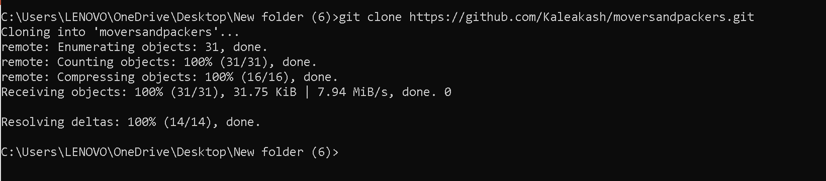
After clone project

Slide 4
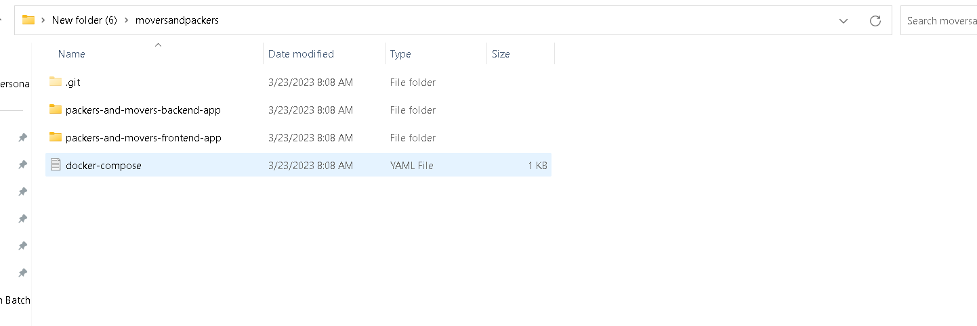
Project structure path

Slide 5
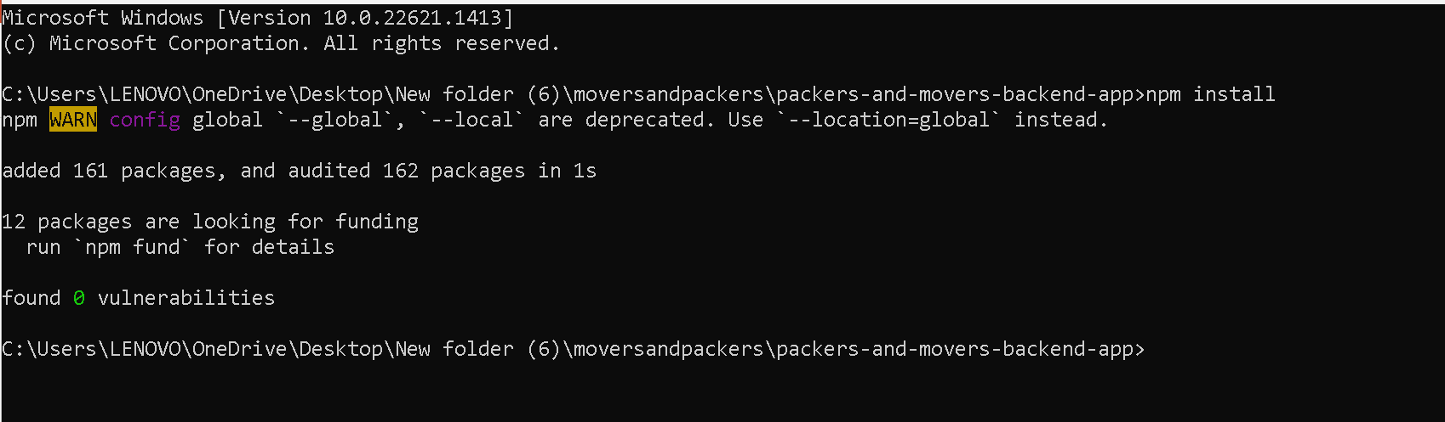
First move inside a packers-and-movers-backend-app
Then run the command as npm install to install all required dependencies.

Slide 6
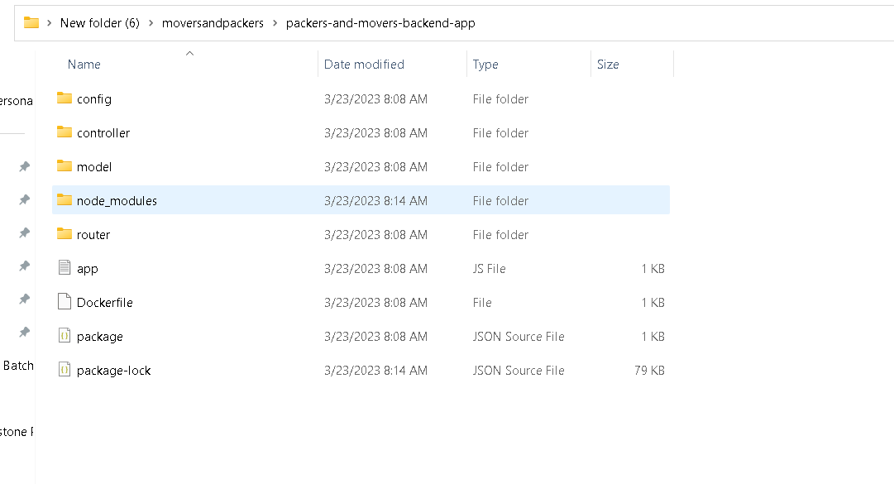
After updated you can see the structure of the project

Slide 7
Project structure explanation
Config : this folder contains database configuration details as well as initial set up for database. If we use local machine database then ip address must be local host or 127.0.0.1 with port number 27017.if we use Docker container then mongo db container name ie present in docker-compose.yml file as database.

Slide 8
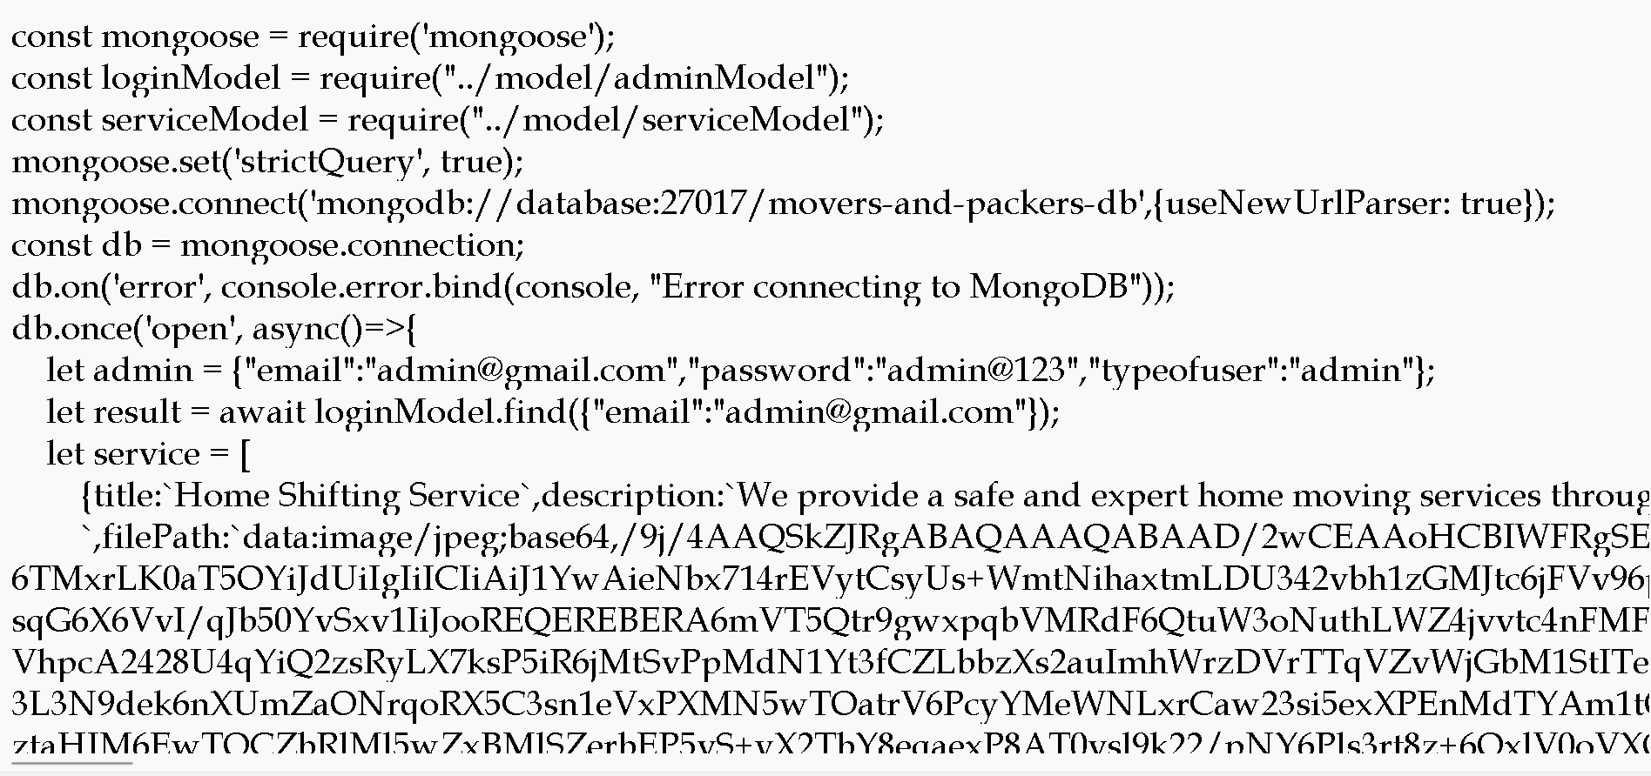

Slide 9
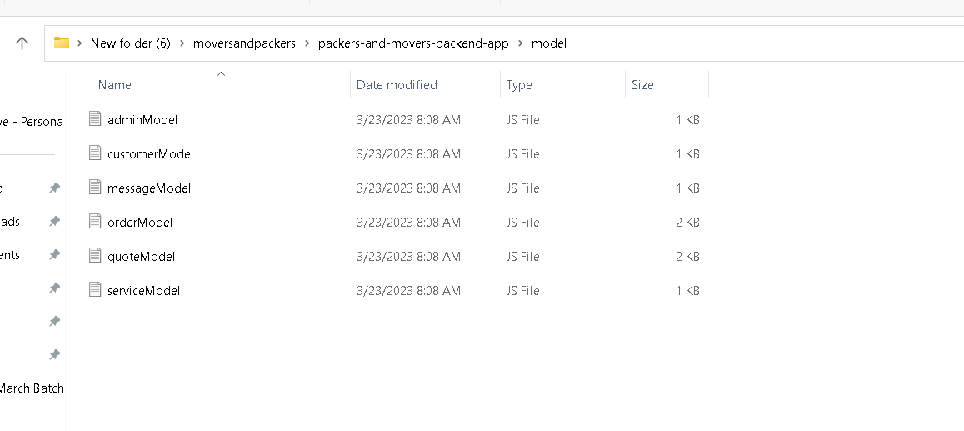
Model file: this file contains the structure of collection with schema definition

Slide 10
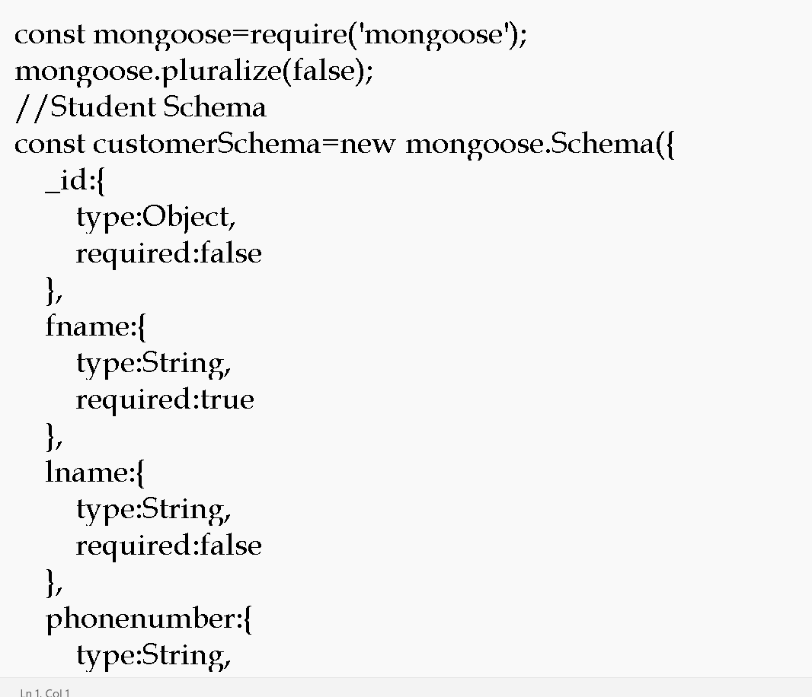

Slide 11
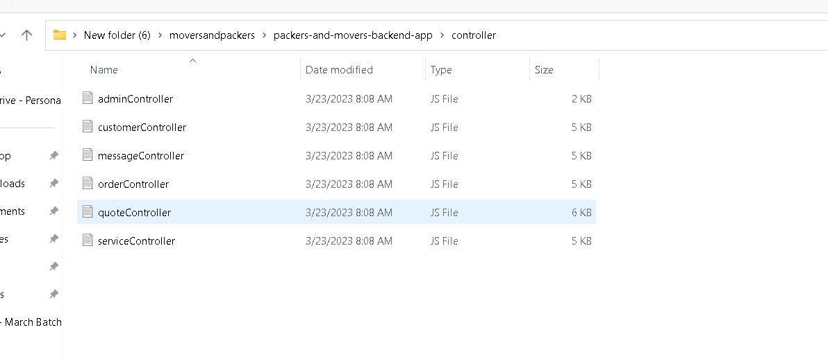
Controller file : which takes req and res and do the operation on model

Slide 12
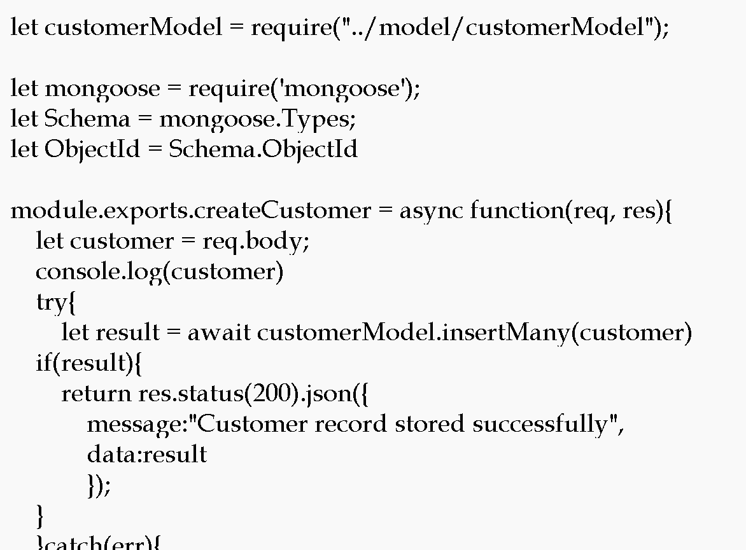

Slide 13
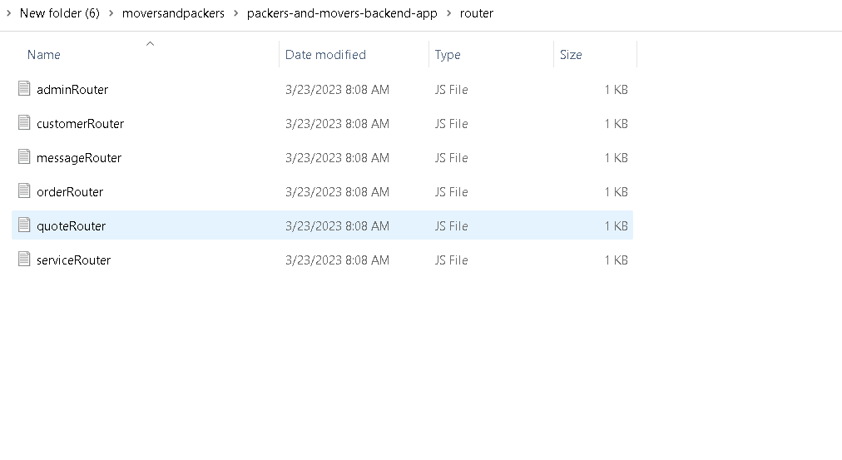
Router : it is use to map the request and http methods.

Slide 14
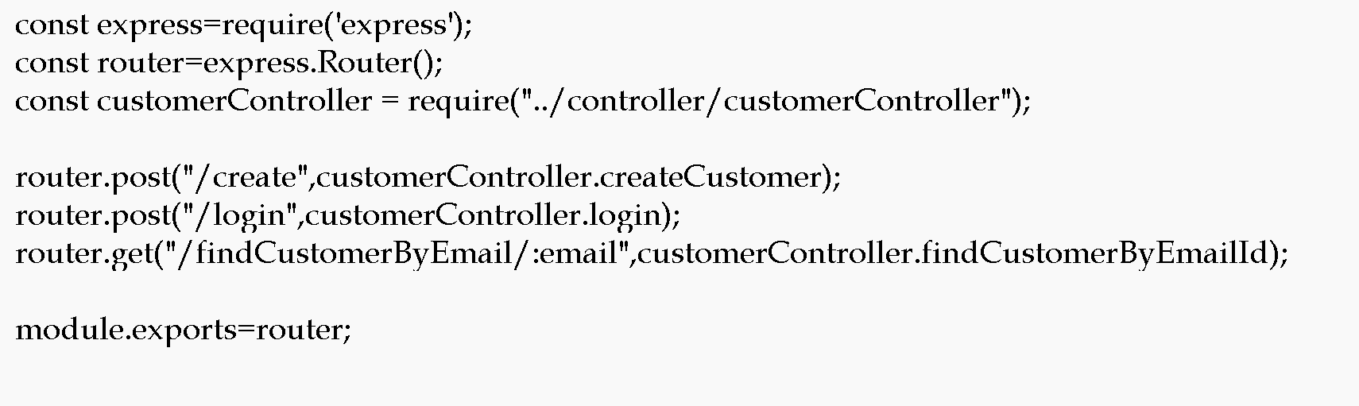

Slide 15
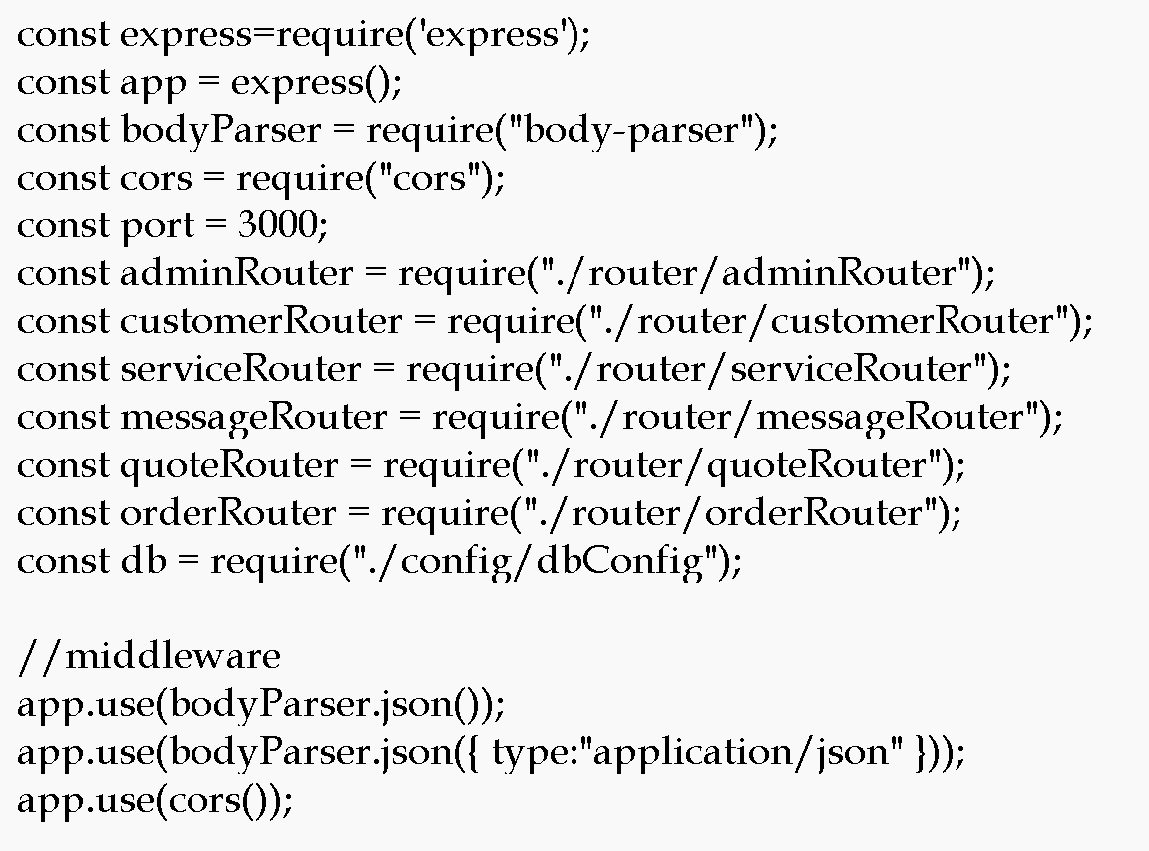
App.js : this is main file. Entry of the application

Slide 16
We will create Dockerfile
We are going to run the project using docker container so we need to create the Dockerfile.

Slide 17
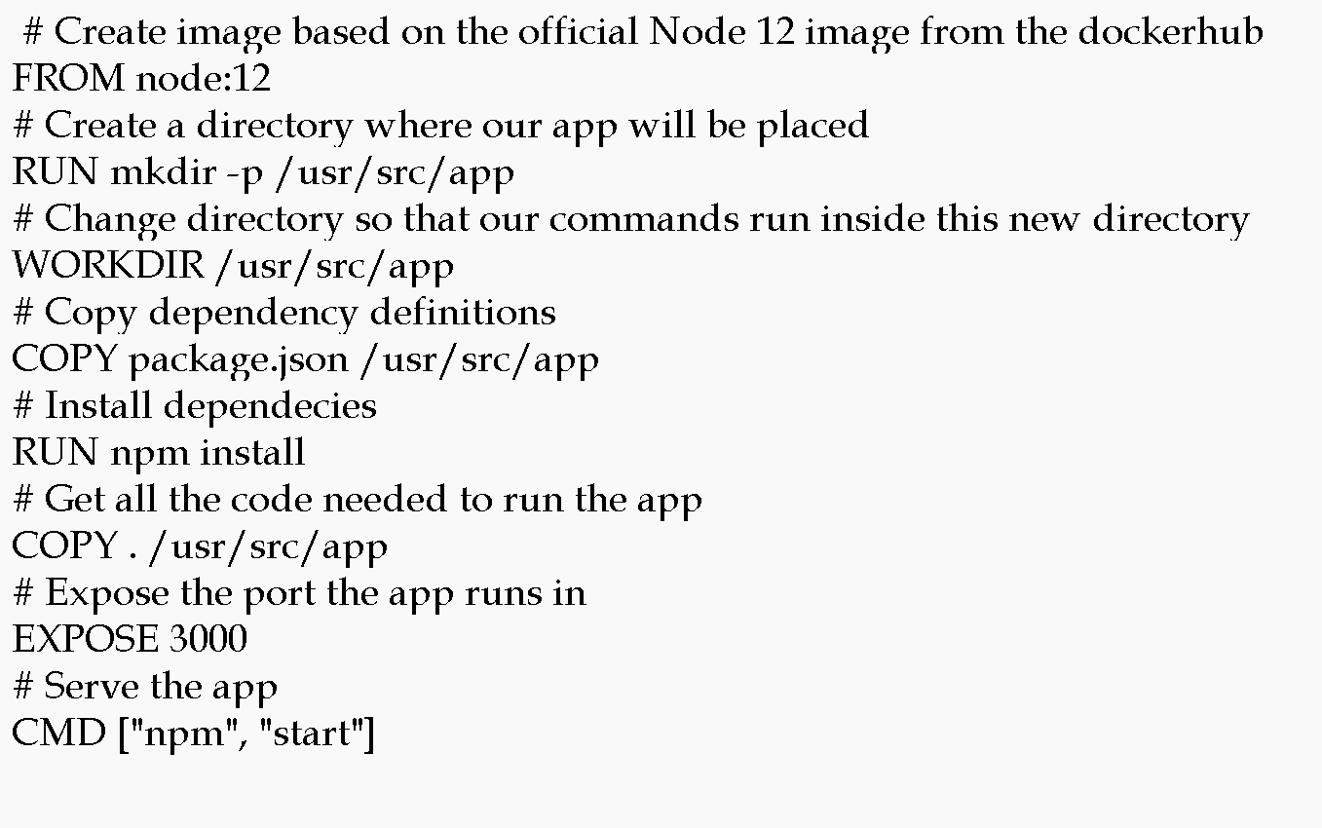

Slide 18
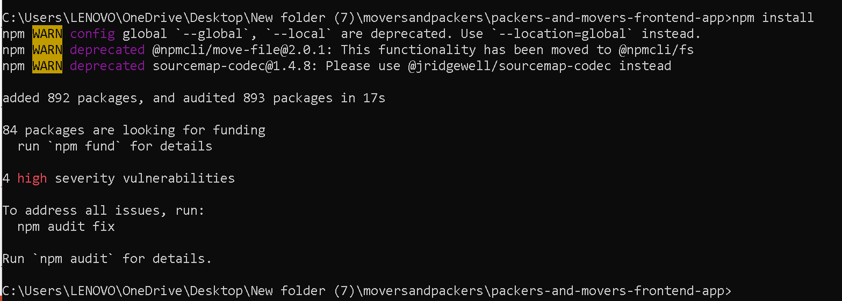
Now move inside a packers-and-movers-frontend-app
Then run the command as npm install to install all required dependencies.

Slide 19
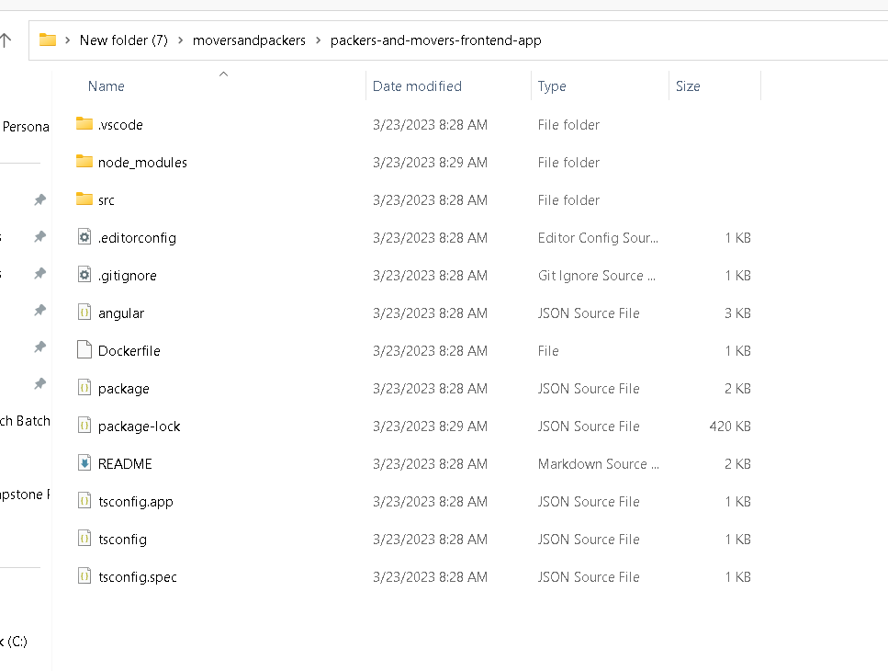
Front – angular project structure

Slide 20
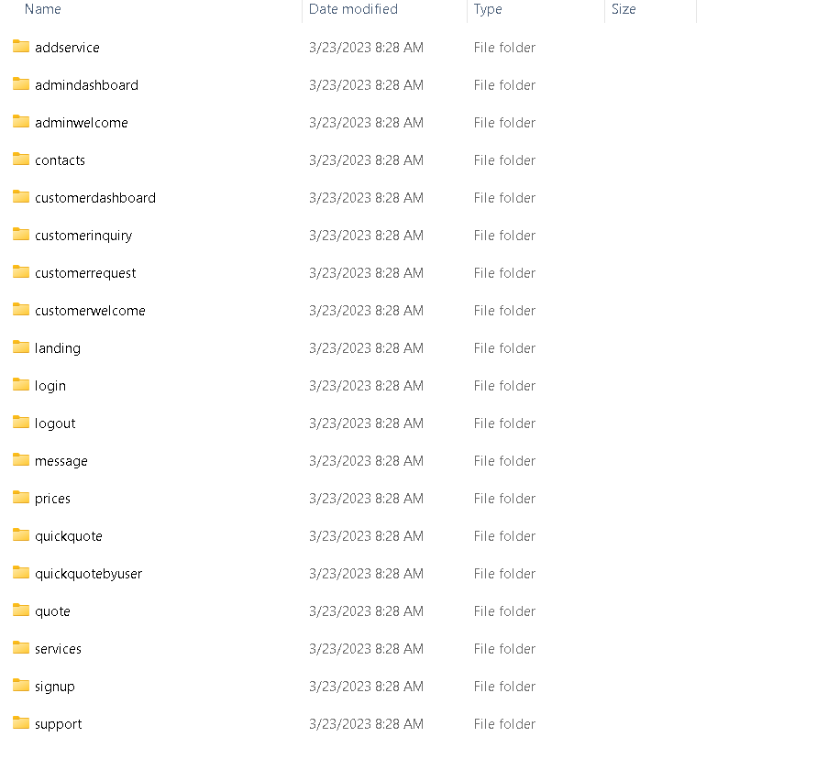
Project structure
Angular project contains lot of components, service as well as model classes .

Slide 21
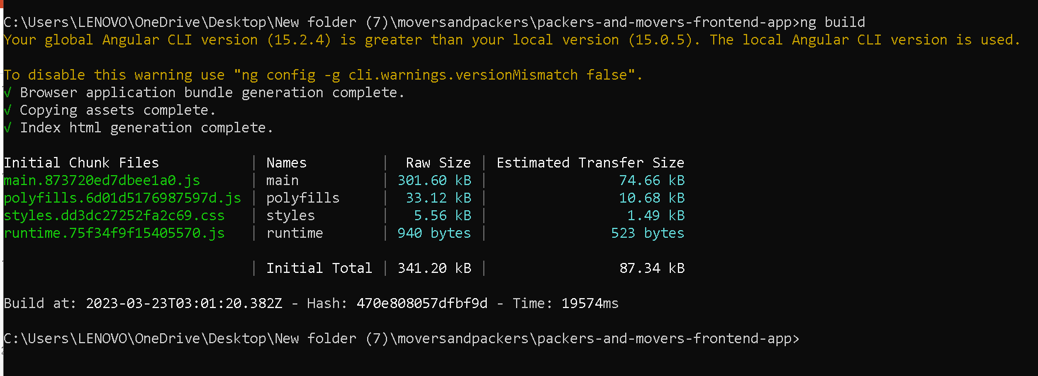
Now build the angular project using command as ng build

Slide 22
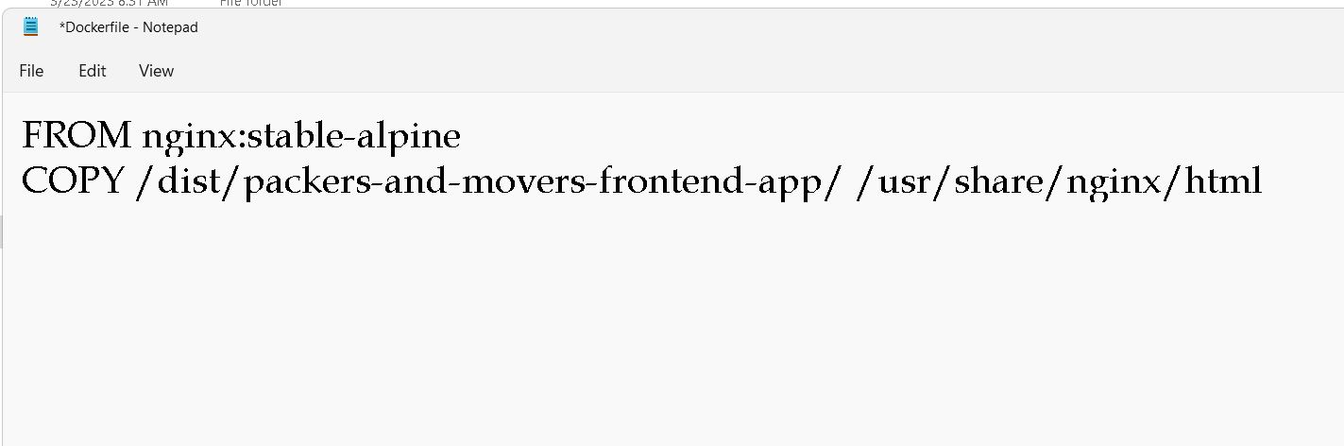
Now we will create the Dockerfile
We are going to run angular project using Dockerfile

Slide 23
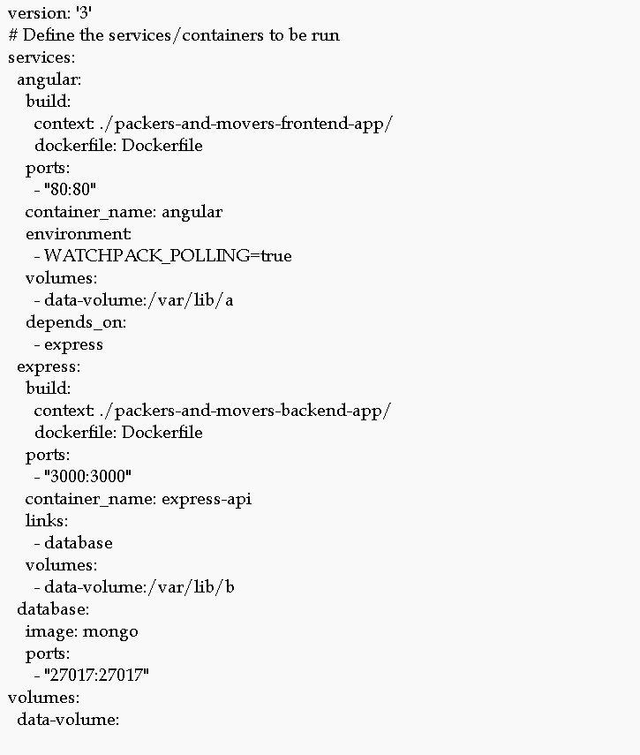
Now will create the docker-compose.yml

Slide 24
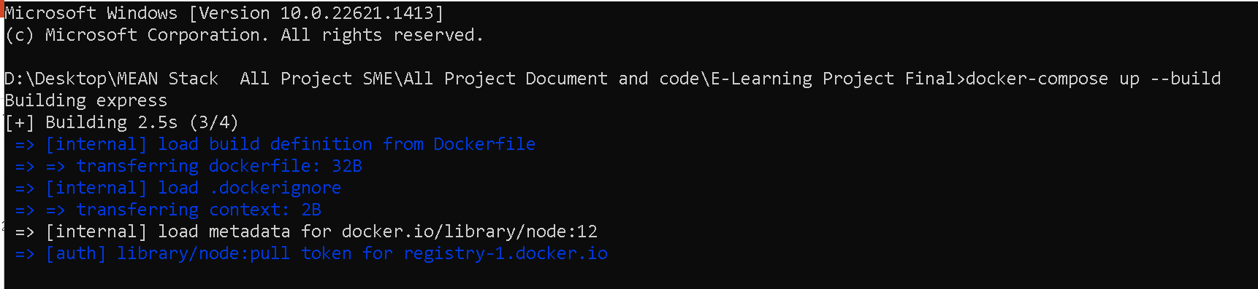
Now run the docker-compose file
docker-compose up –build

Slide 25
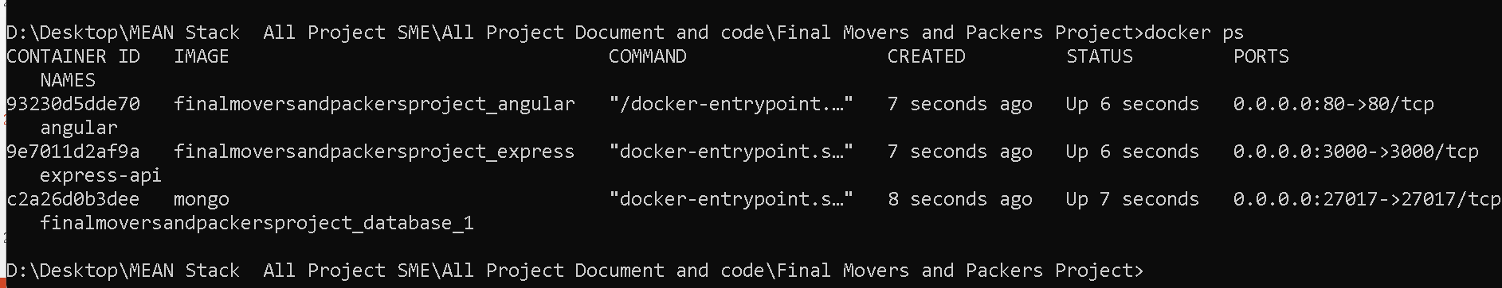
If everything go fine
Then three container get start.
Open another terminal and check the container status.

Slide 26
Container details
Angular running with nginx server with 80 port number.
Express js running on port number 3000 port number
Mongo db database running on 27017 port number.

Slide 27
Now run the application using url as
http://localhost:80

Slide 28
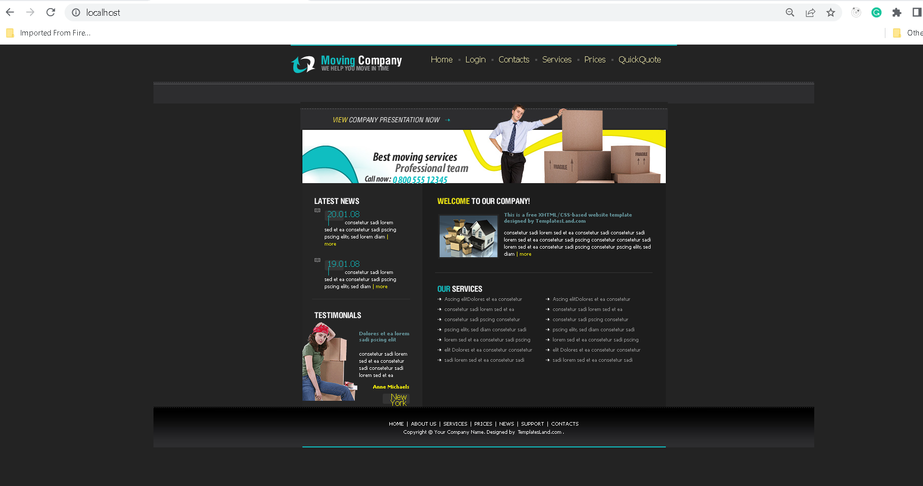

Slide 29
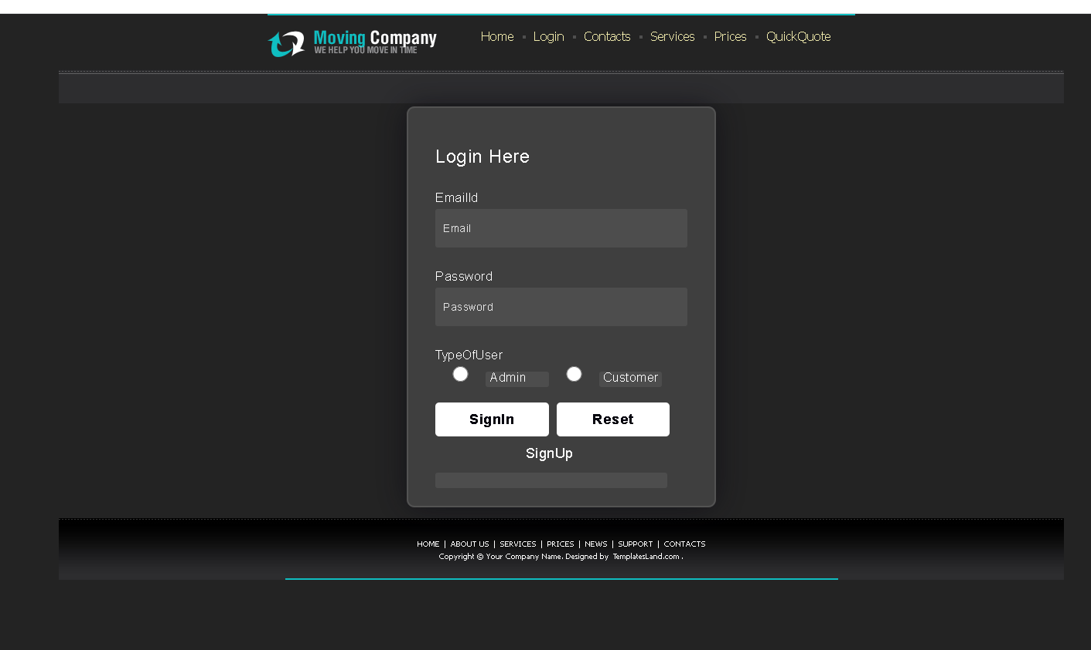
Login

Slide 30
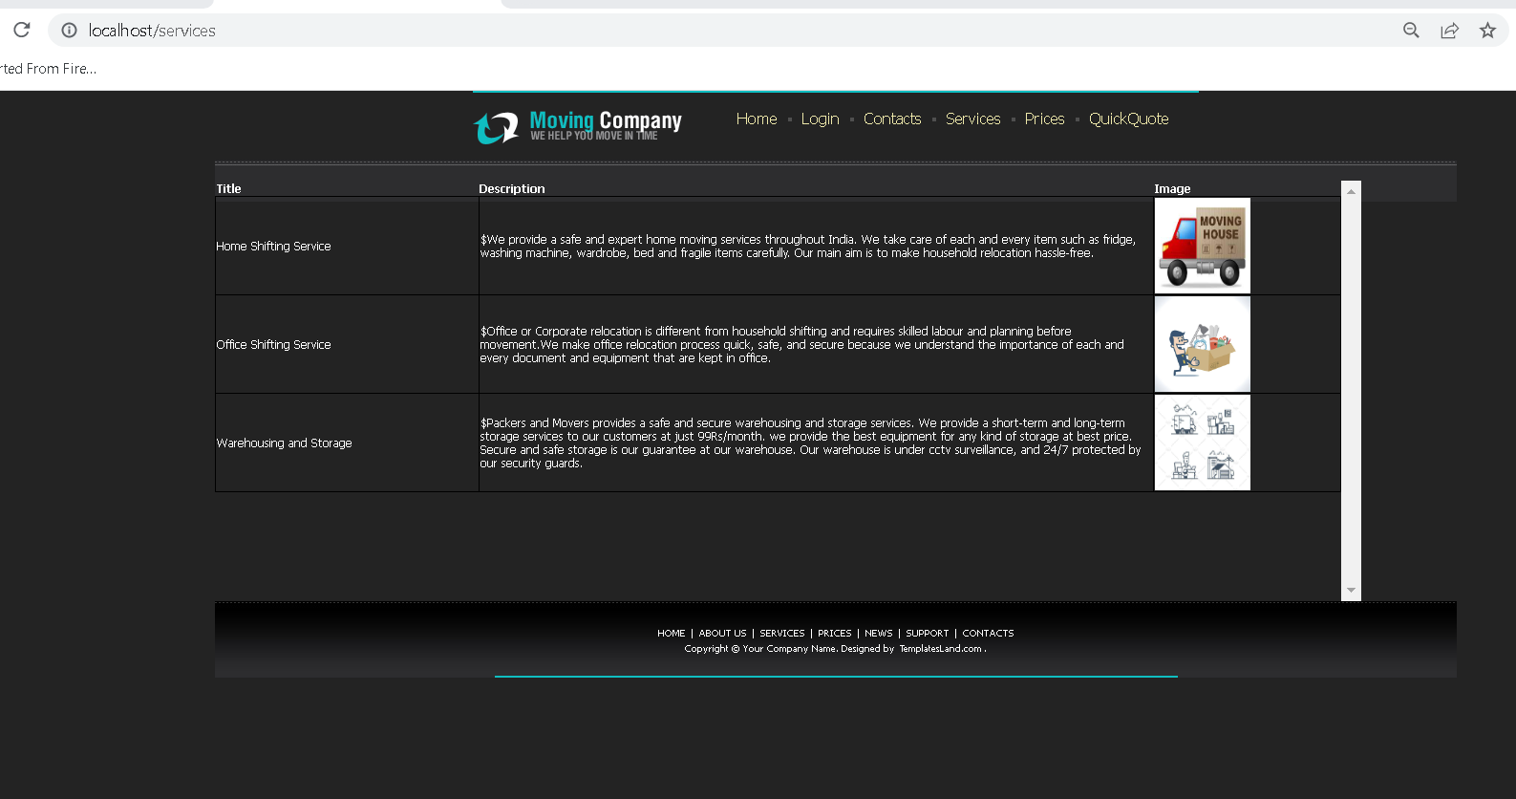
Services

Slide 31
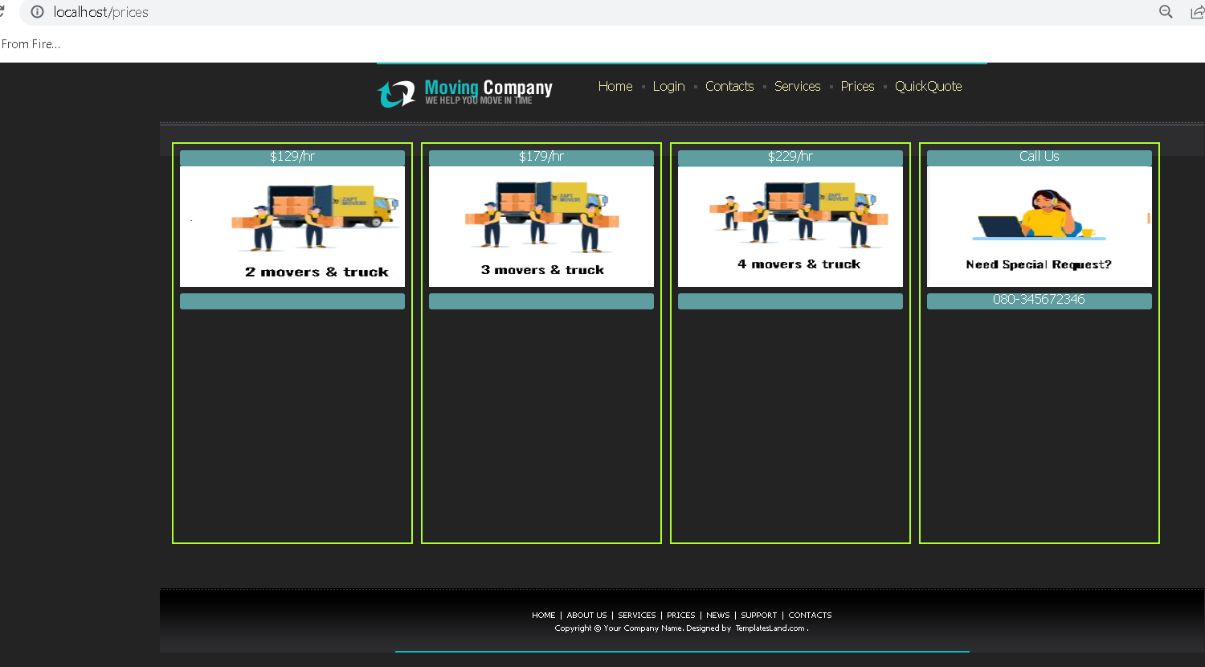
Prices

Slide 32
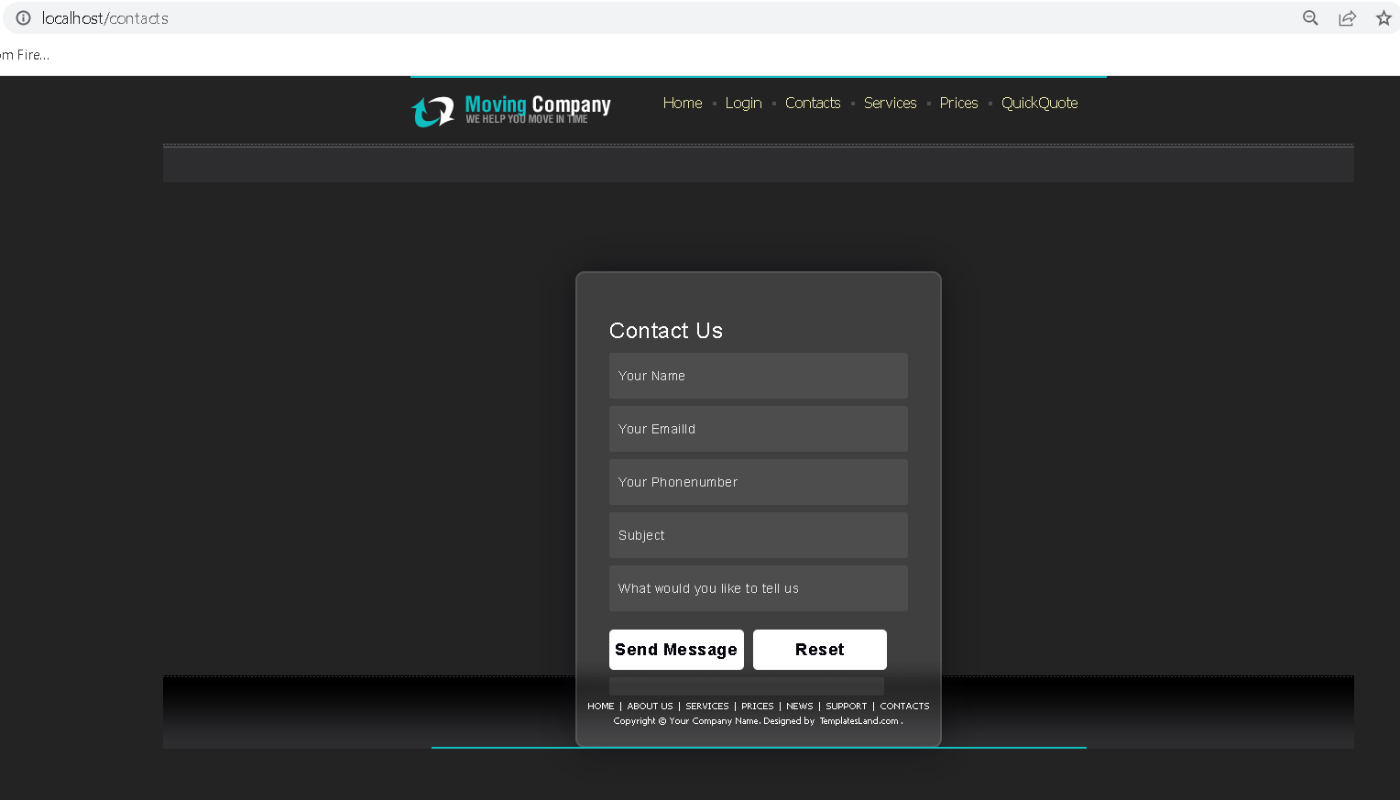
Guest user can send the message

Slide 33
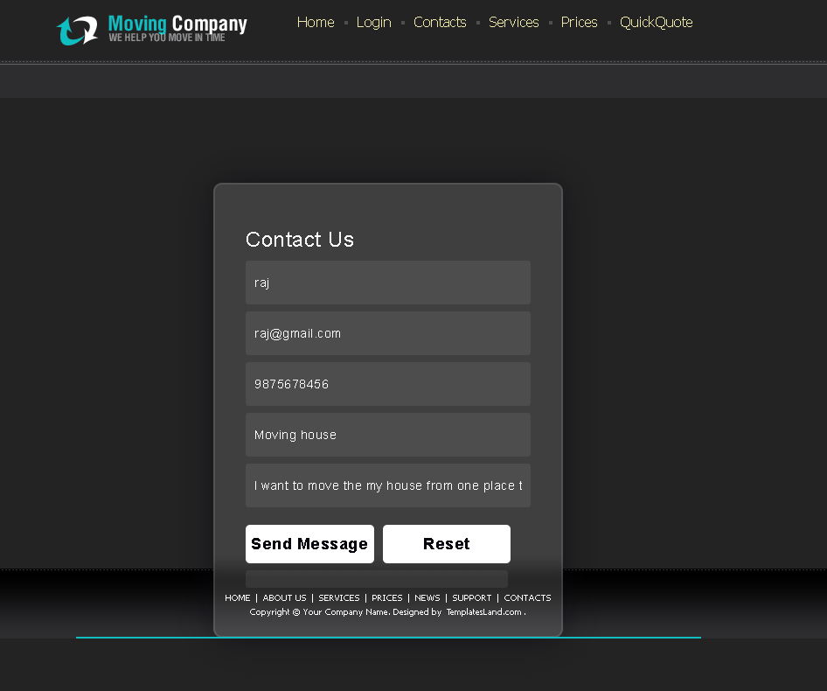
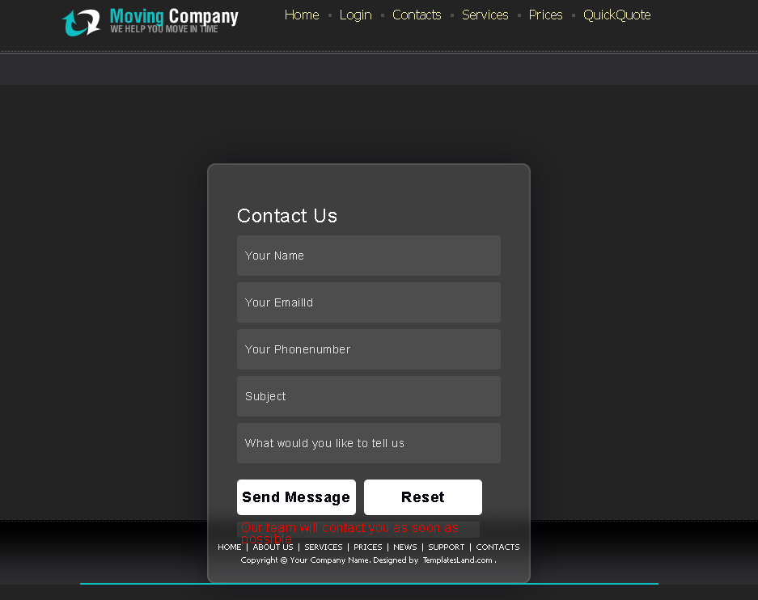
Contact us

Slide 34
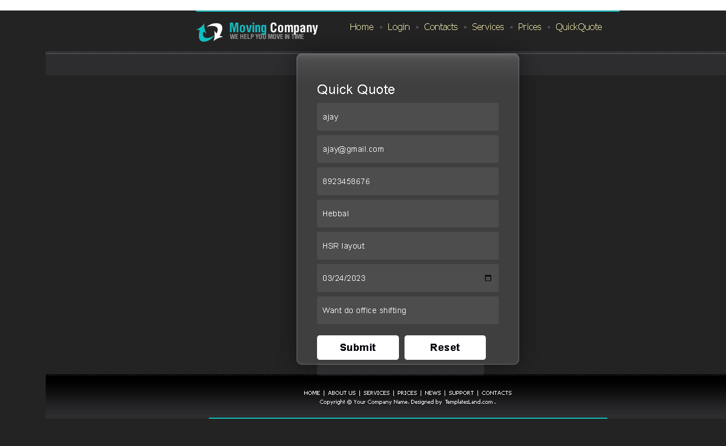
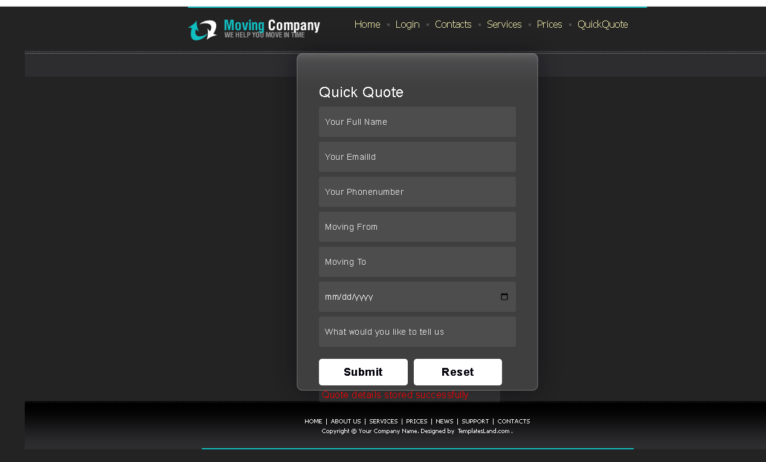
Quick quote by guest user

Slide 35
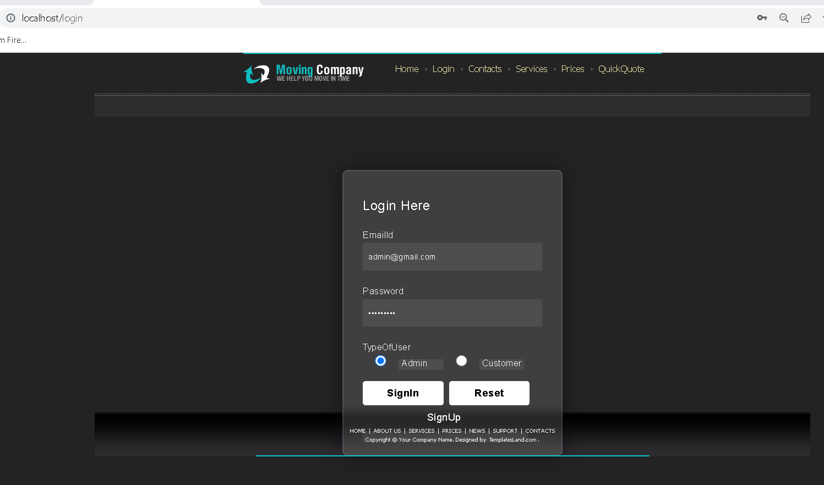
Admin login with emailid as admin@gmail.com and password as admin@123

Slide 36
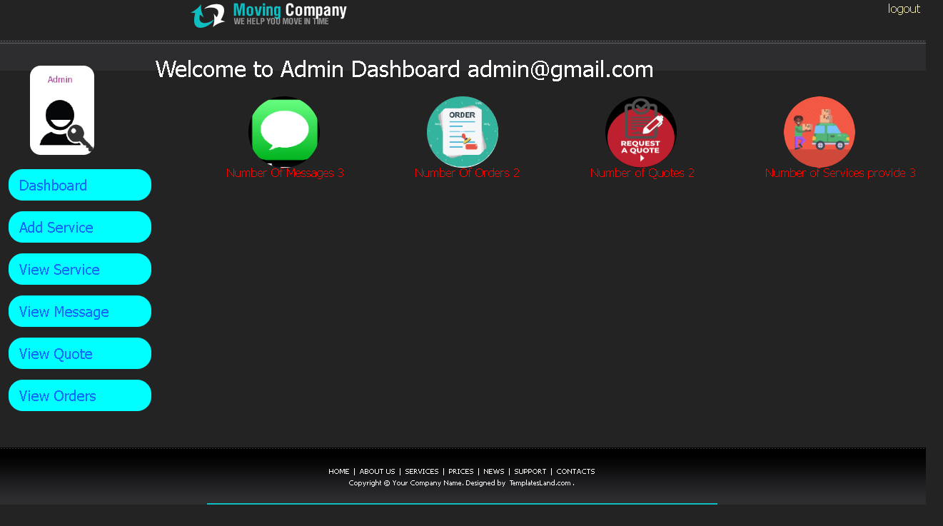
Admin home page

Slide 37
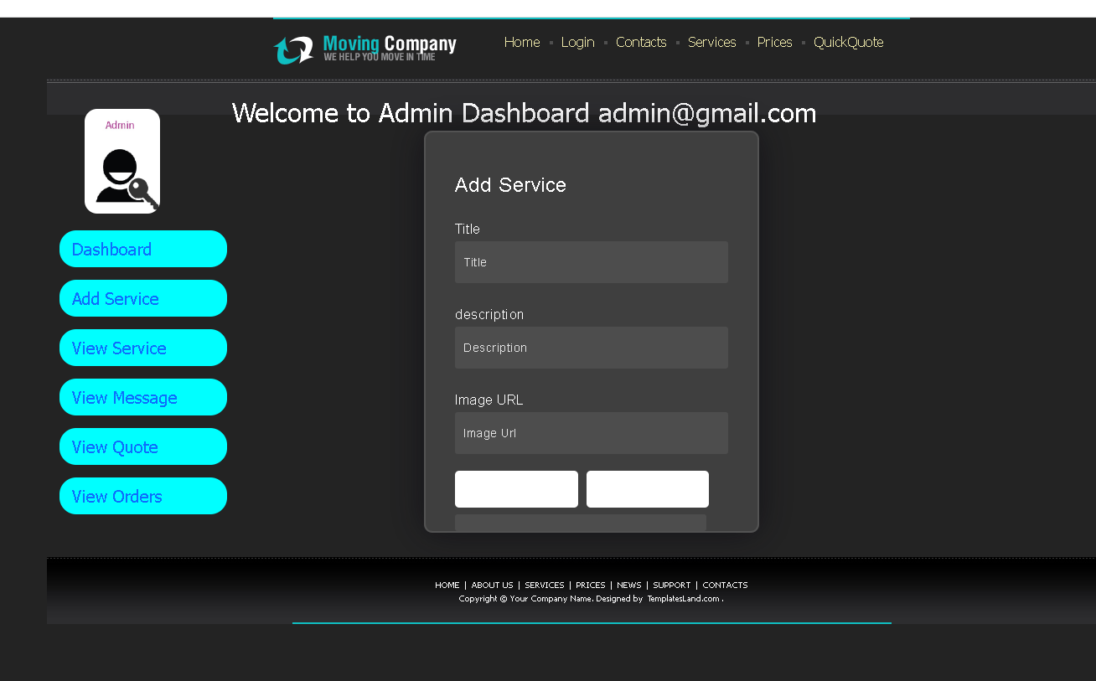
Admin can add the new service

Slide 38
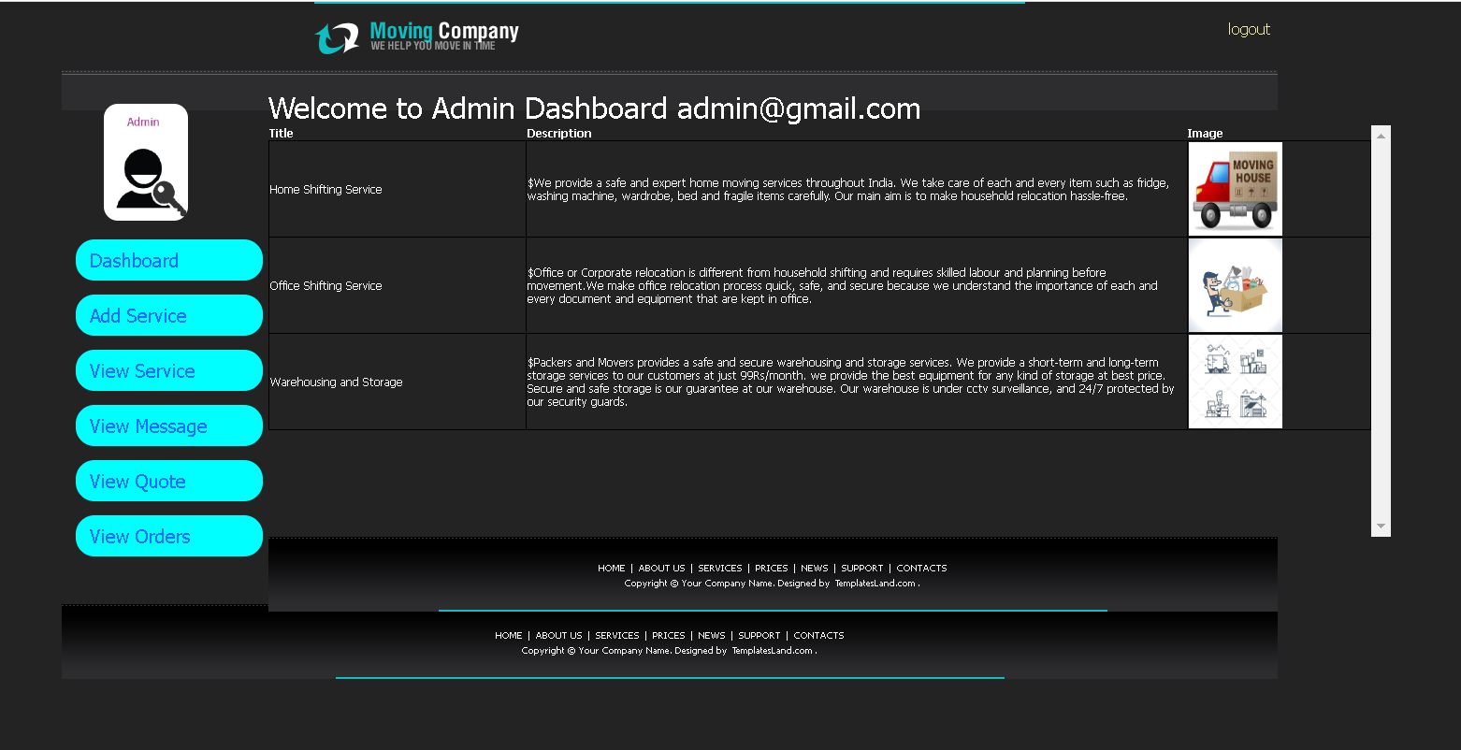
Admin can view existing services

Slide 39
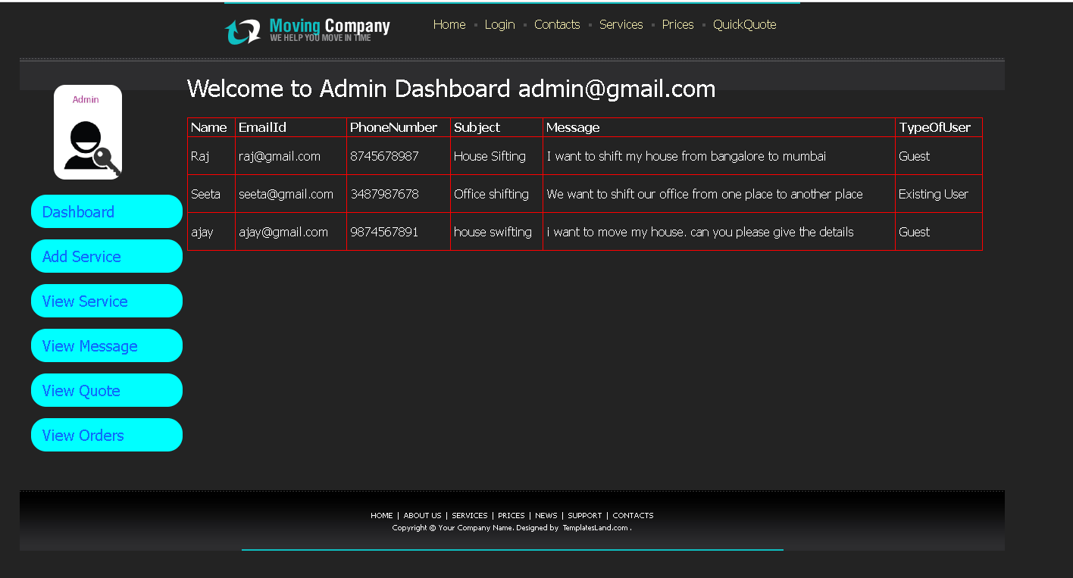
Admin can view the messages sent by guest user or existing user

Slide 40
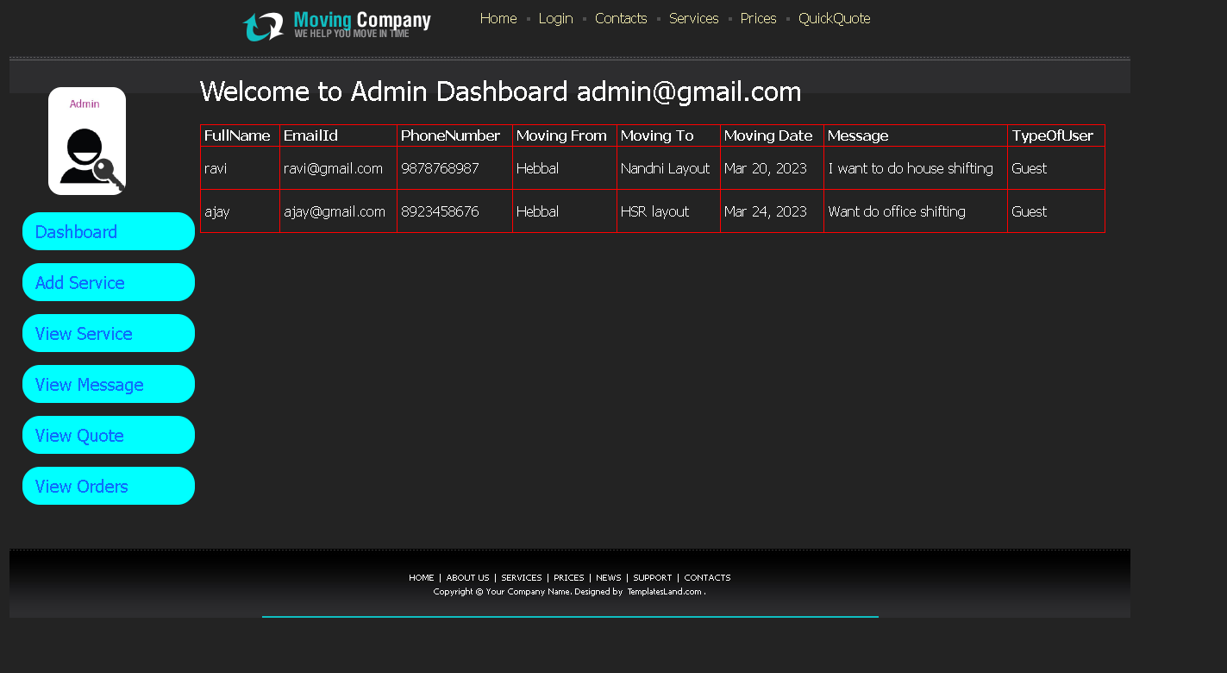
Admin can view the quote details send by guest user or existing user

Slide 41
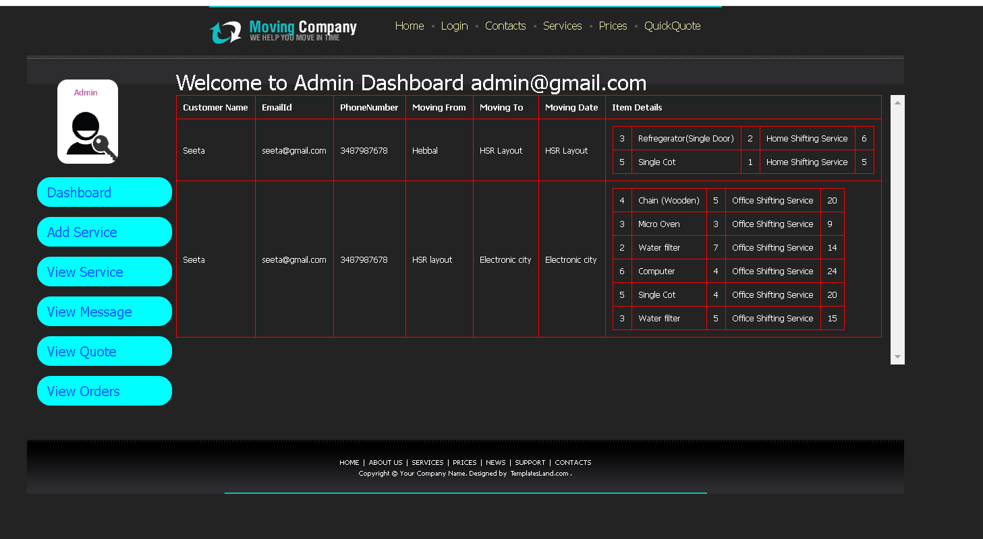
Admin can view order details sent

Slide 42
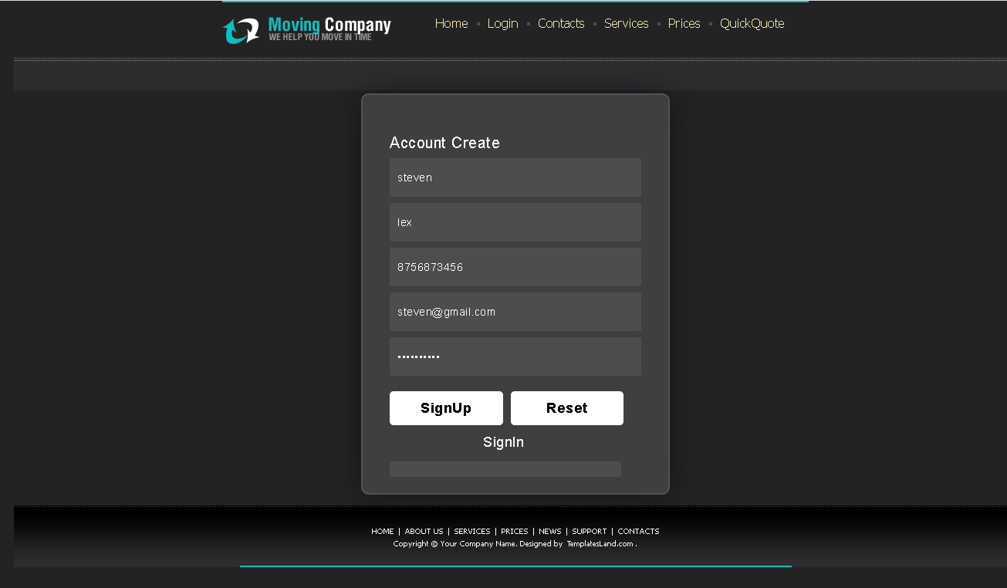
Now we will create customer account

Slide 43
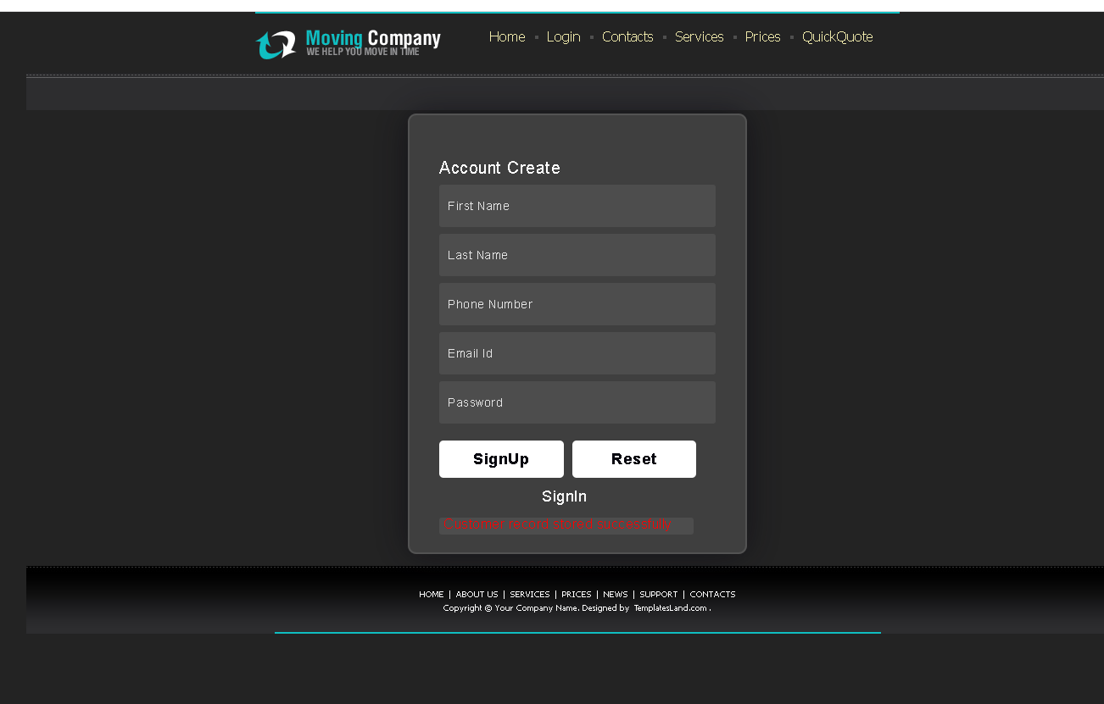
After customer account created

Slide 44
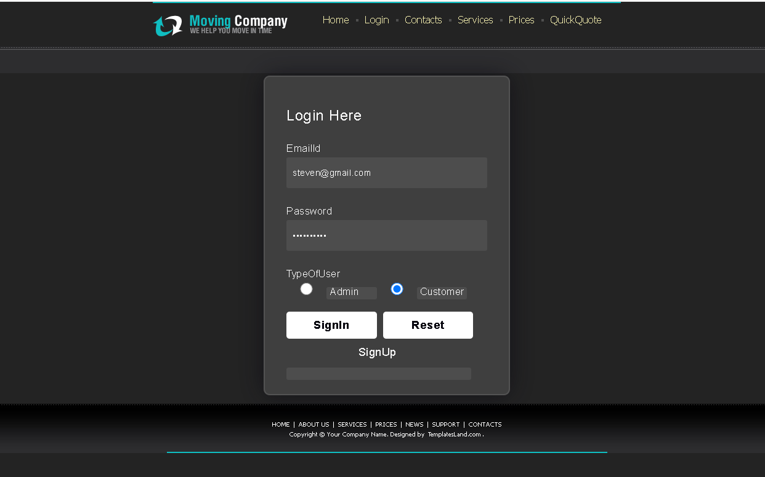
Customer login

Slide 45
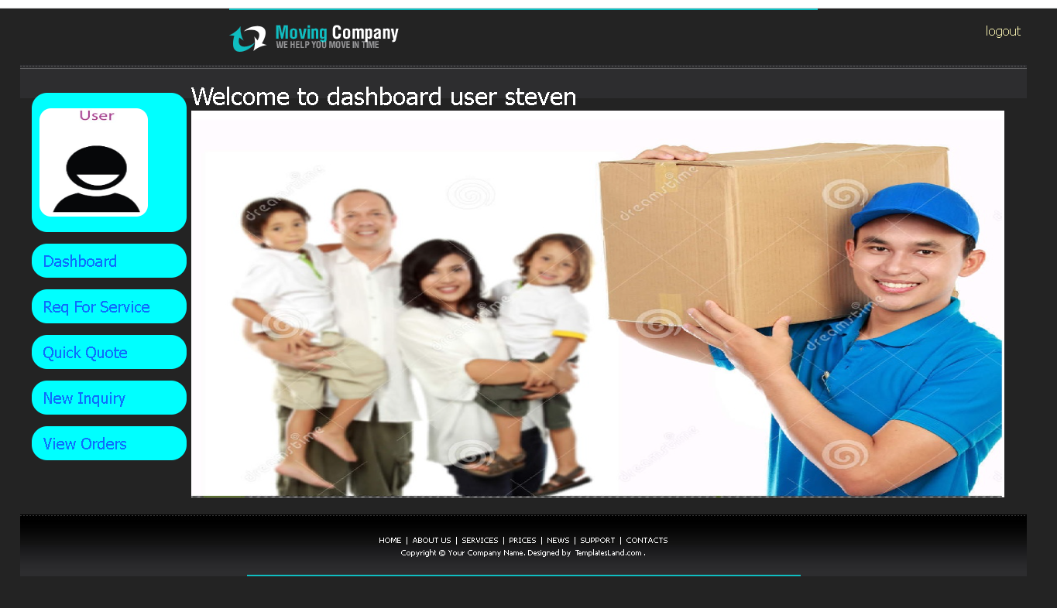
Customer home page

Slide 46
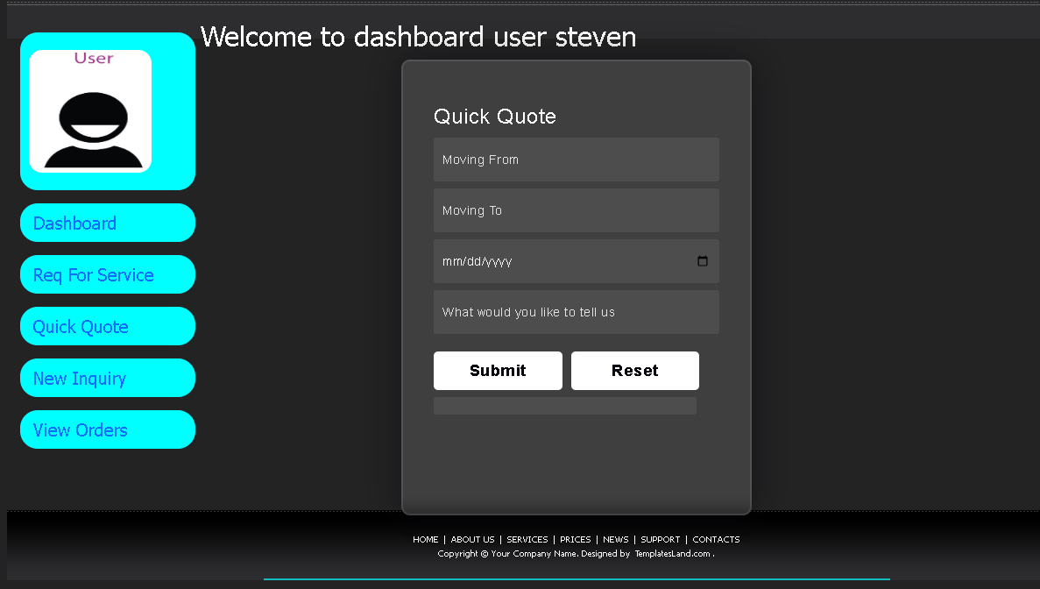
Quick quote by customer

Slide 47
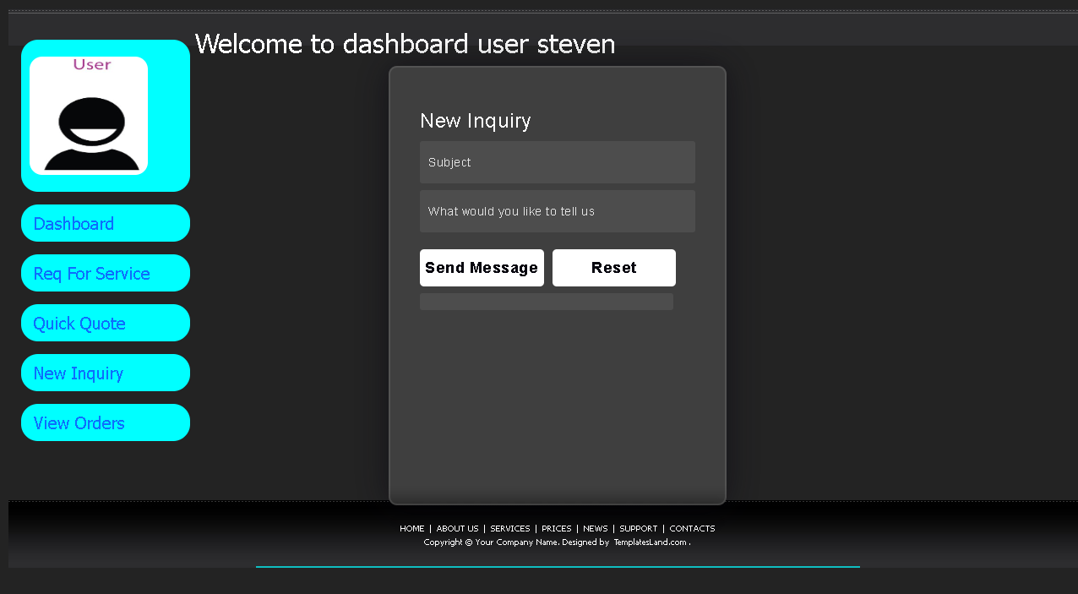
Quick inquiry by customer

Slide 48
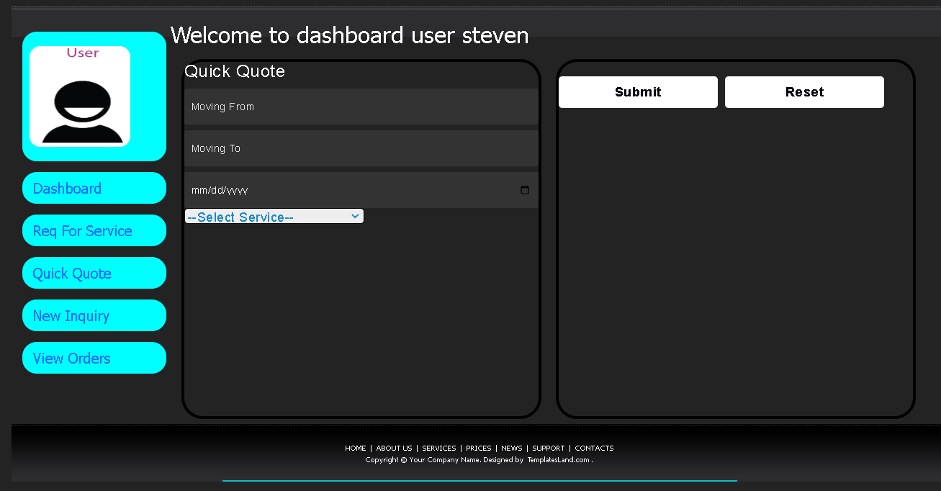
Request by customer

Slide 49
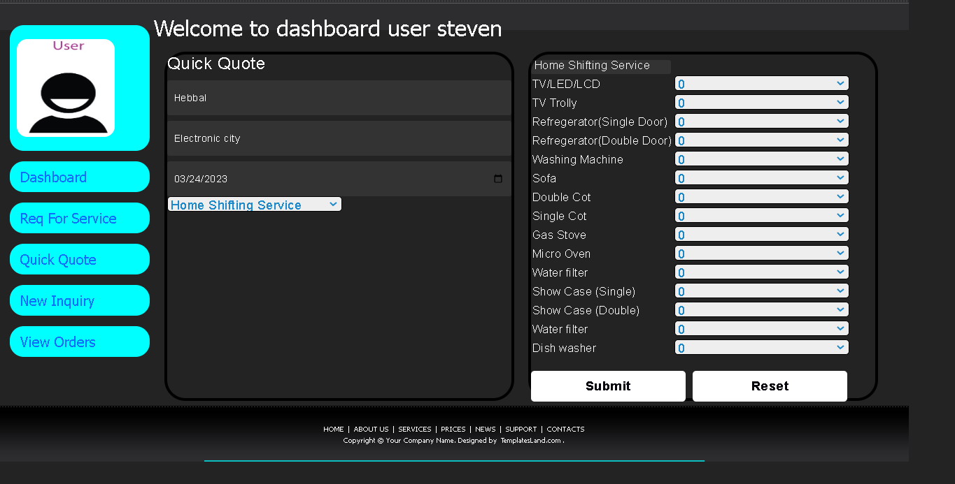
After selected specific service by customer

Slide 50
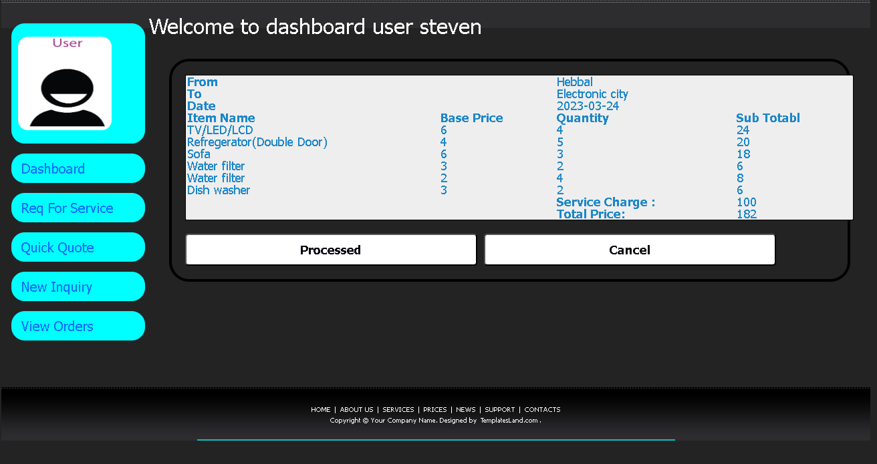
After filled all details

Slide 51
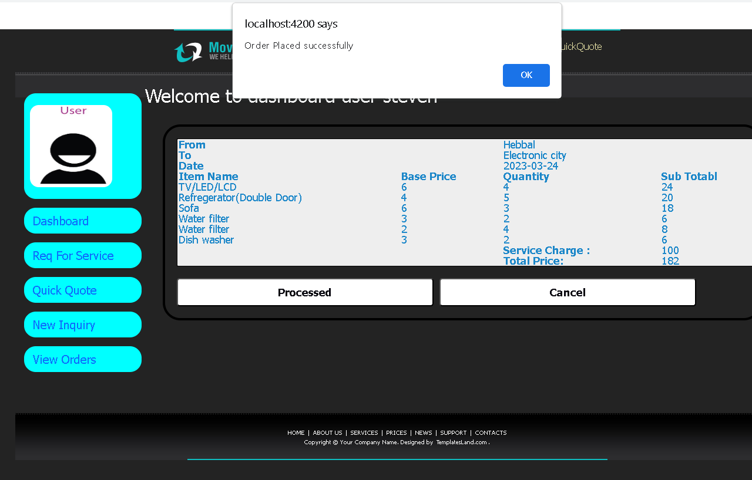
Then processed the request

Slide 52
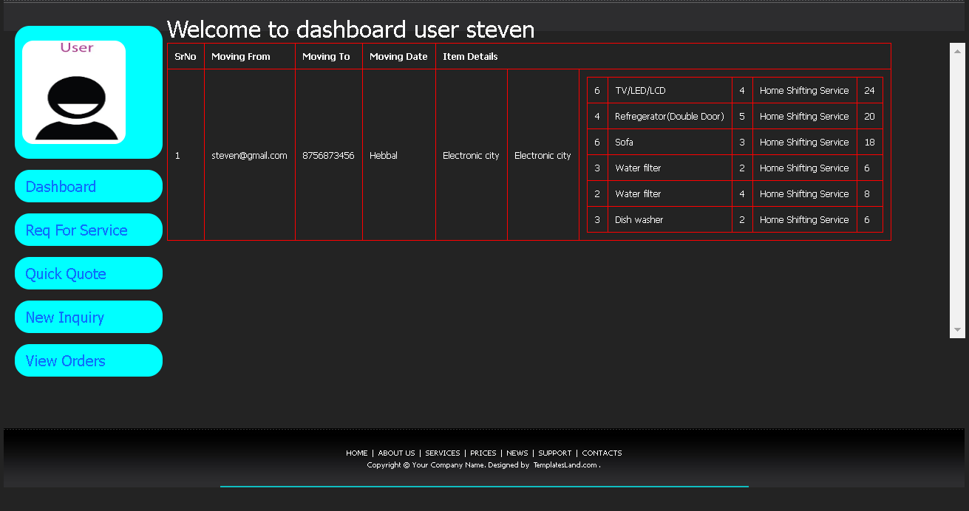
View order details

Slide 53
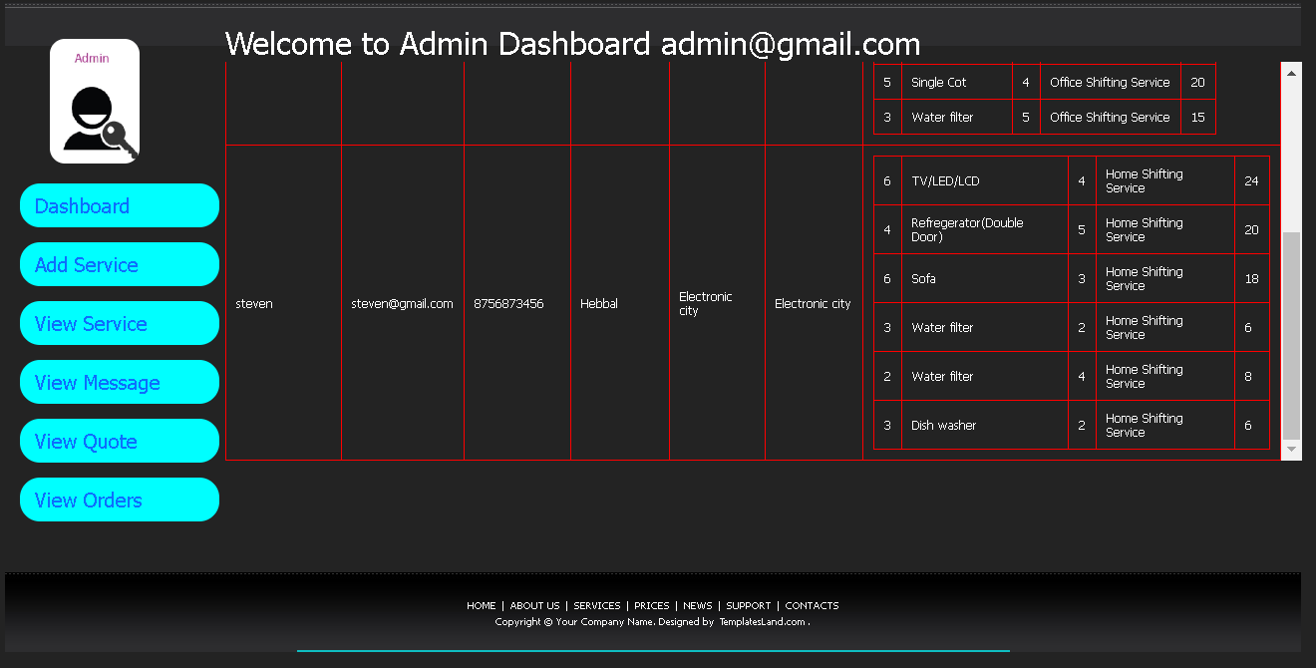
Admin can view order placed by customer

